Slide 1
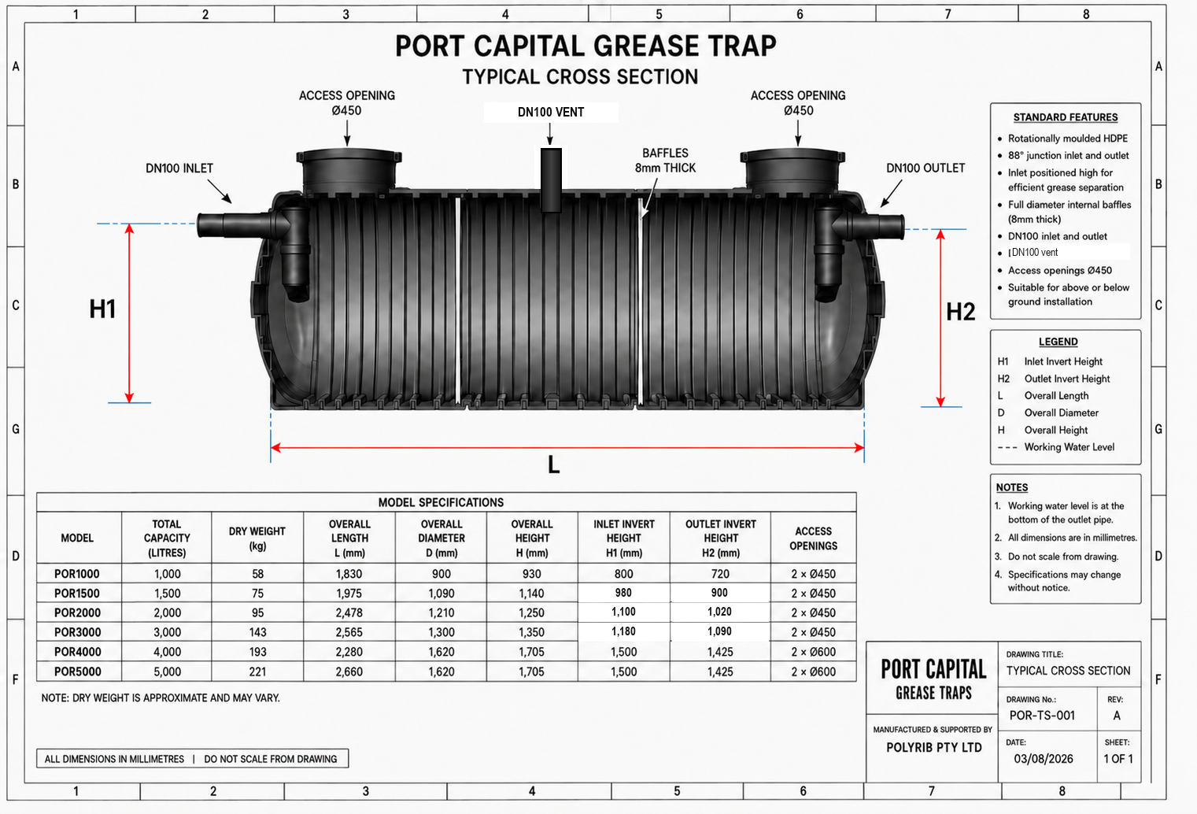
MODEL SPECIFICATIONS - 18 OCTOBER 2026
MODEL | TOTAL CAPACITY (LITRES) | DRY WEIGHT (kg) | BODY LENGTH L (mm) | BODY WIDTH W (mm) | OVERALL HEIGHT H (mm) | INLET HEIGHT H1 (mm) | OUTLET HEIGHT H2 (mm) | ACCESS OPENINGS
PCGT1000 | 1,000 | 58 | 1,800 | 900 | 980 | 800 | 720 | Confirm
PCGT1500 | 1,500 | 75 | 2,060 | 1,000 | 1,150 | 980 | 900 | Confirm
PCGT2000 | 2,000 | 95 | 2,478 | 1,200 | 1,300 | 1,100 | 1,020 | Confirm
PCGT3000 | 3,000 | 143 | 2,565 | 1,300 | 1,400 | 1,180 | 1,090 | Confirm
PCGT4000 | 4,000 | 193 | 2,280 | 1,620 | 1,755 | 1,500 | 1,425 | Confirm
PCGT5000 | 5,000 | 221 | 2,660 | 1,620 | 1,755 | 1,500 | 1,425 | Confirm
Dimensions updated from supplier POR1000-POR5000 schedule. PCGT names retained.
Cross-section is a schematic from the earlier document. Dry weights restored from the original specifications. Confirm connections and openings for the supplied model.
H1/H2 follow supplier labels; confirm datum before setting pipe inverts. Do not scale.
Notes:
Dimension source: supplier table supplied by Craig, WhatsApp Image 2026-10-17 at 3.40.02 PM.jpeg. New drawing and technical update dated 18 October 2026. Cross-section preserved from source; no engineering redesign or new certification claimed. Dry weights restored from original specifications at Craig's direction; opening sizes require confirmation.

Slide 2
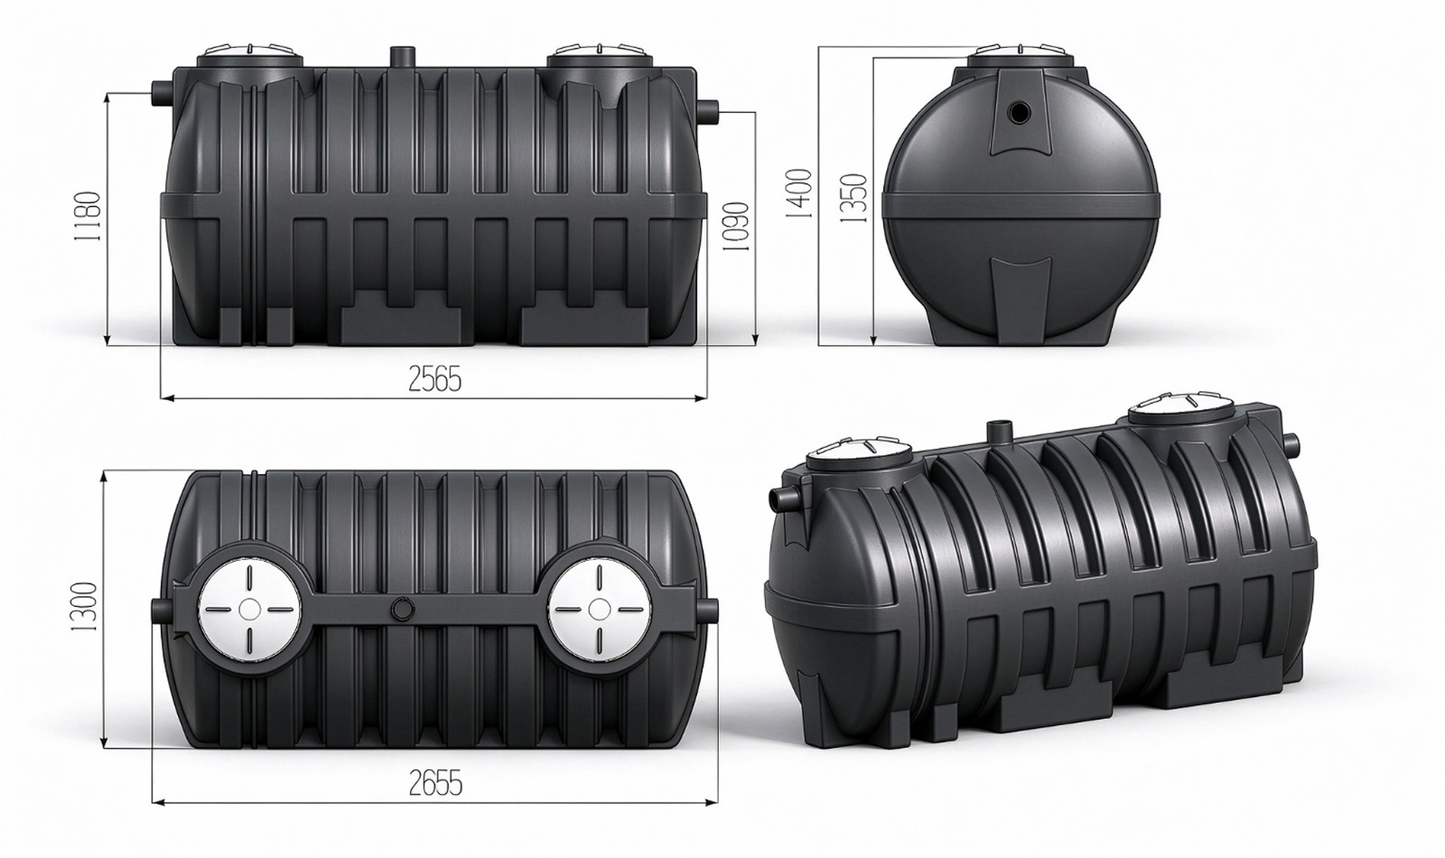
PCGT3000 / POR3000 supplied model drawing
3,000 L | 143 kg approx. | Body 2565 x 1300 x 1400 mm | H1 1180 mm | H2 1090 mm
Supplier drawing as received. Overall connection length 2655 mm; secondary height 1350 mm. Do not scale. | polyrib.au
Notes:
Actual 3000 L supplier drawing supplied by Craig on 18 October 2026, replacing the adapted 2000 L illustration. Body dimensions and H1/H2 match supplied schedule. Original listed approximate dry weight 143 kg retained.

